Slide 1
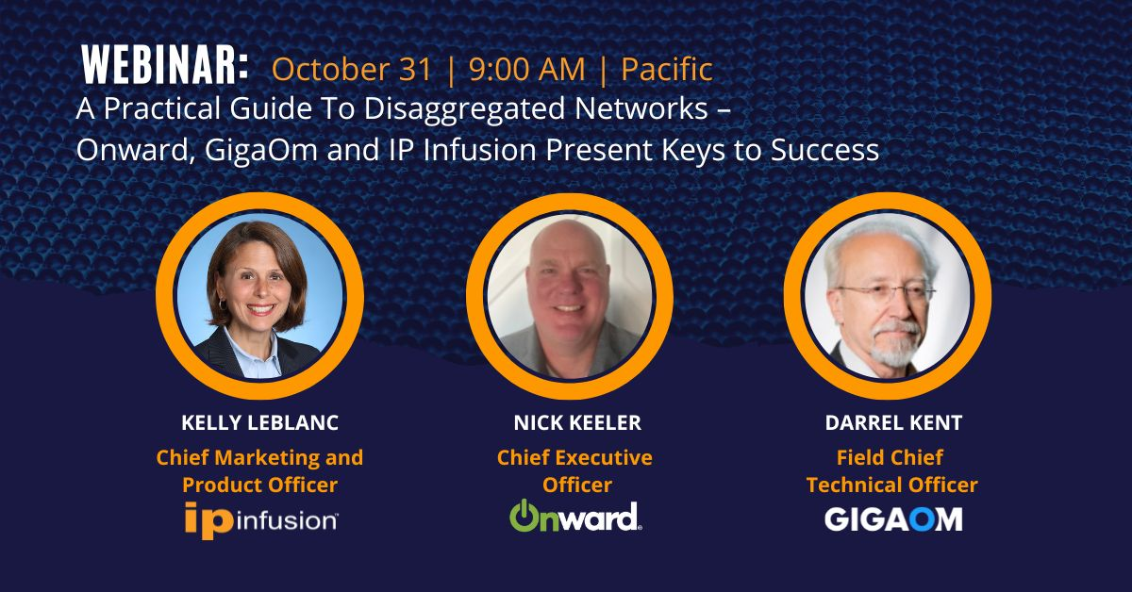

Slide 2
Today’s Agenda A Practical Guide to Disaggregated Networks
Introductions
Introduction to Network Disaggregation with Open Networking
GigaOm 2024 Network Operating System Radar Report
Onward’s Open Networking Journey
Q&A
Speakers
Kelly LeBlanc
Chief Marketing and Product Officer
Nick Keeler
Chief Executive Officer
Darrel Kent
Field Chief Technical Officer

Slide 3
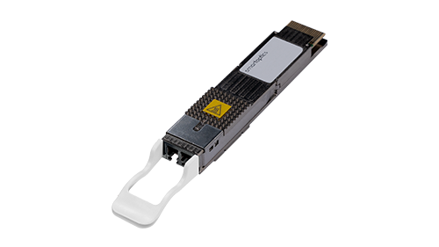
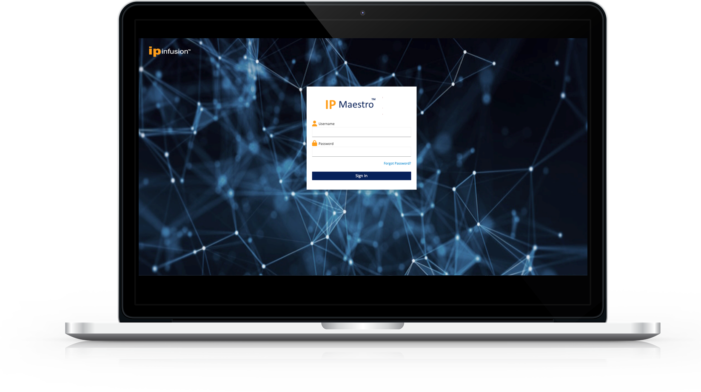
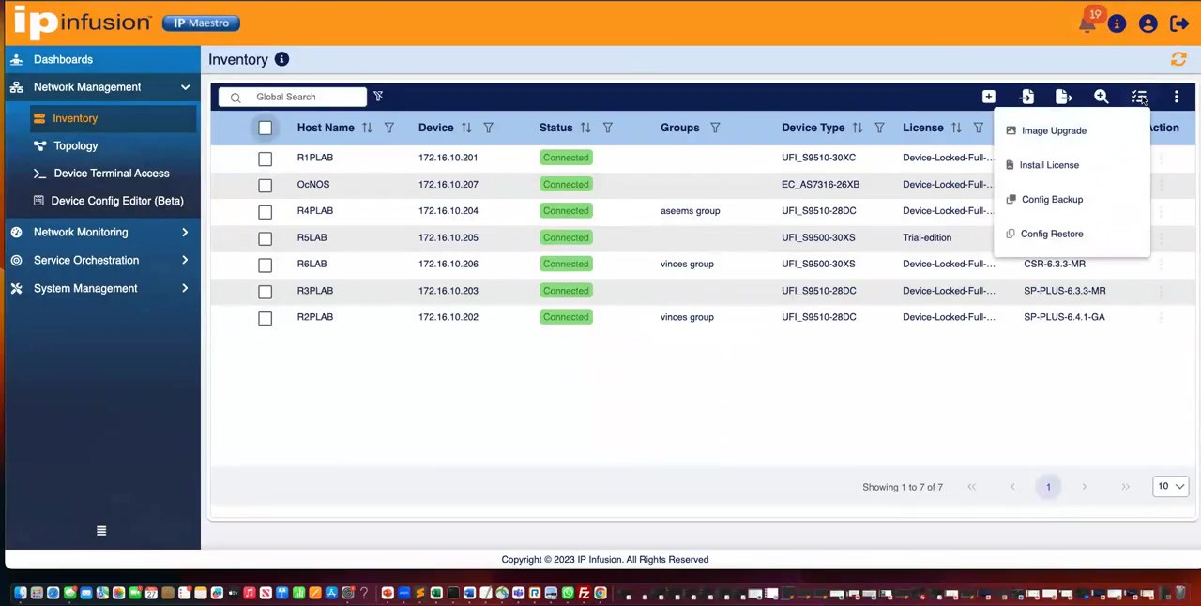
IP Infusion Advantage for Open Networking
Most Comprehensive
Open NOS
The Widest HW Solution Ecosystem
Open Optics
Ecosystem
Centralized Monitoring and Management
24/7 Professional
Support
600+
Modern Networking Features
40+
Supported Hardware Platforms
100+
Qualified Optical Transceivers

Slide 4
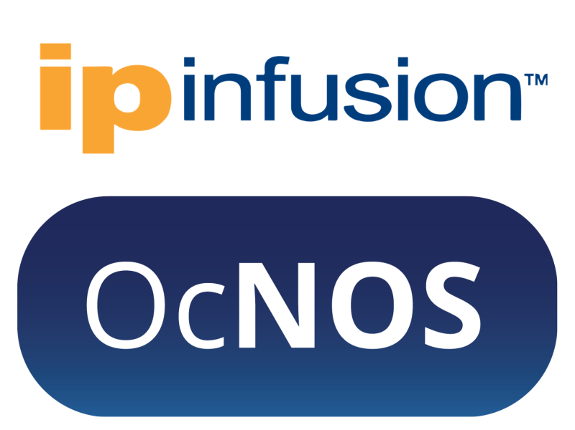
End-to-End Open Networking Solution for Carriers and Data Centers
Mobile Access
Fixed Wireless Access
Data Center
OcNOS-Enabled
Network Elements
Spine
CSR
Access Router
Leaf
Enterprise
PON Access
Aggregation Network
Core Network
Aggregation Router
ZR+
ZR+
PE
Residential
PE
Provider Edge
P Router
BGP Peering
BGP Peering
Enterprise
Cable Access
Enterprise
Ethernet Access
Routed Optical Network
Data Center Interconnect
R-Mac PHY
Residential
Access Router
Residential
Access Router
Transponder
Transponder
Provider Edge,
BGP Peering
R-PHY
L2 | L3
Timing Sync
Carrier Ethernet
SR-MPLS
MPLS w EVPN
EVPN-VxLAN
Streaming Telemetry
Access
Access Routers, CSR, L3
Aggregation
Open Aggregation Routers, DCI
Core Network
PE, P, Routers. BGP Peering
Data Center
DC-CLOS, Multi-Tenant, Lossless Fabric, OOB
Capacity Range: 32 Gbps – 14.4 Tbps | Port Speeds: 100M - 400G
Capacity Range: 128 Gbps – 51.2 Tbps | Port Speeds: 100M - 800G

Slide 5
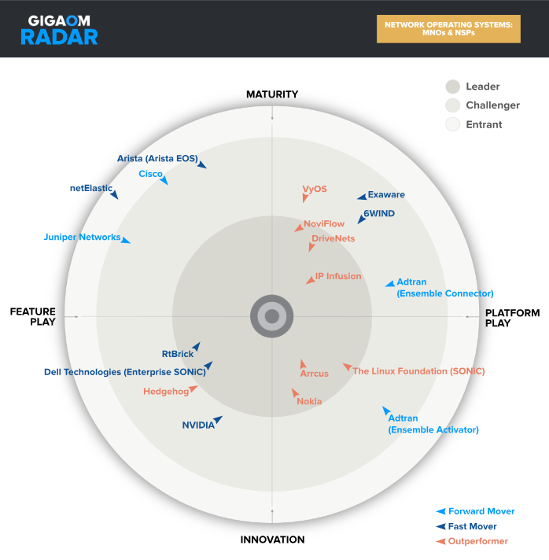
2024 GigaOm NOS Radar IP Infusion: Leader & Outperformer For Fourth Consecutive Year
Leader & Outperformer: All 3 Reports
MNOs and NSPs
Cloud Service Provider (CSP)/MSP
Enterprise & SMBs
Platform Player Of Choice
Outranked Incumbents
Cisco, Juniper, Arista
Strengths: OcNOS is one of the most mature, complete, and field-tested disaggregated NOSs available.
Source: GigaOm 2024 NOS Radar
GigaOm Ranks IP Infusion as a Leader Outperformer

Slide 6
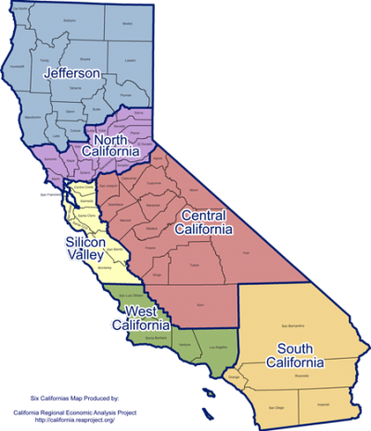
IP Infusion Customer Win: Onward
California-based full-fiber broadband provider deploys IP Infusion OcNOS® networking software products to service business and residential customers.
Onward has deployed IP Infusion’s OcNOS-SP-MPLS networking software packages for core and aggregation routing services.
UfiSpace S9600-32X provides the hardware platform for 100Gbps core and aggregation services. UfiSpace S9502-12SM provides a fanless and temperature hardened platform.
“We were upgrading a previous networking platform that had become problematic over time. The OcNOS product worked well with several different vendors’ boxes, and was an easy drop-in solution that can grow with us.”
-Nick Keeler, CEO of Onward

Slide 7
Onward Scales Broadband Network with OcNOS Broadband Use Case in USA | Fiber Network Service Provider
Use Case:
Broadband Network Upgrade
Solution Deployed:
OcNOS
IP Infusion OCNOS-SP-MPLS-32
IP Infusion OCNOS-SP-MPLS-2400
Hardware
UfiSpace S9502-12SM | 100M/1/10G Open Switch
UfiSpace S9600-32X | 100G Open Switch
Reasons for Selecting OcNOS:
Seamless interoperability with existing networking equipment
Easy integration with netElastic for edge networking functions
Enhanced network scalability and capacity
Support for multi-vendor hardware and optics, offering flexibility
Stability improvements over legacy networking products
Complete bundled solution (hardware + software) with a single point of contact for maintenance
Temperature-hardened hardware for varied deployment environments
Reduced Total Cost of Ownership (TCO) via network disaggregation
netElastic BNG/CGNAT
S9600-32X
Peering Edge
S9501-12SM
Enterprise
Residential/SMB

Slide 8
Q&A

Slide 9
Thank You!
www.ipinfusion.com

